Slide 1

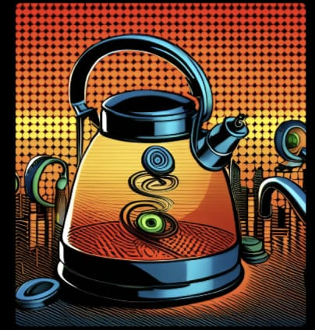
TEAM JOE
JOY OF ELECTRONICS
TOPIC :
ELECTRIC KETTLE

Slide 2

TEAM MEMEBERS:
1: K.HARSHAVARDHAN
2: J.VISHAL REDDY
3: P.VENIL VENKAT REDDY
4: VAMSHI KRISHNA
5:SAI VAMSI
This Photo by Unknown author is licensed under CC BY.

Slide 3
What is an electric kettle?
Kettles are among the simplest of household appliances. Lift the lid and peer inside and you'll see, at the very bottom of the water container, a coil of thick metal called the heating element. When you plug the kettle into an electrical outlet, a large electric current flows into the heating element. The element's resistance (the tendency any material has to stop electricity flowing through it) turns the electrical energy into heat. In other words, the element gets hot. Since it's in direct contact with cold water, the heat passes to the water by conduction and rapidly warms it up too.

Slide 4
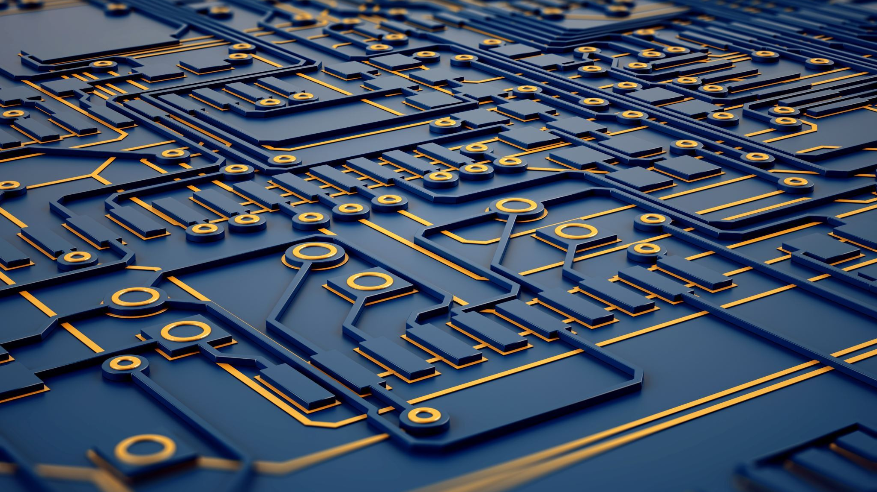
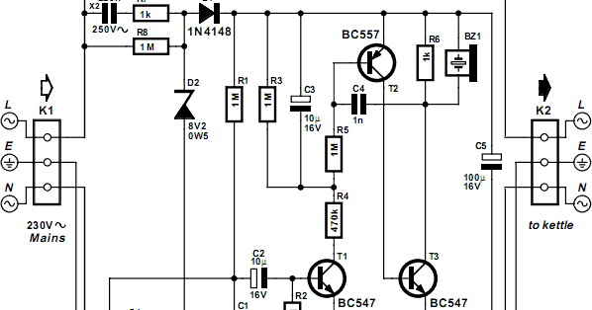
CIRCUIT DIAGRAM:

Slide 5
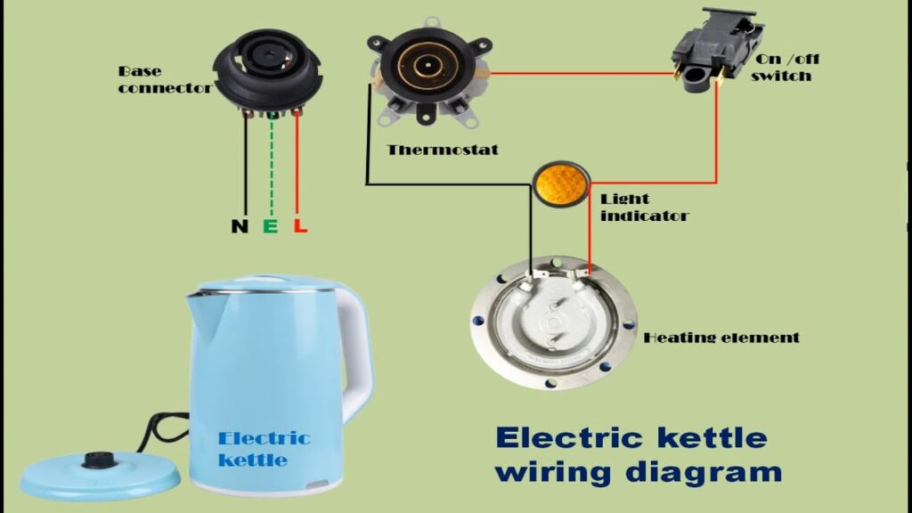
ELECTRIC KETTLE CONSISTS OF THE FOLLOWING COMPONENETS:
POWER INPUT
SWITCH
HEATING ELEMENT
THERMOSTAT
INDICATOR LIGHT
WATER LEVEL SENSOR
CORD AND PLUG

Slide 6
An electric kettle works on the principle of converting electrical energy into heat energy to rapidly heat water. The main components involved in the functioning of an electric kettle are the heating element, thermostat, and power supply.
Here's a step-by-step explanation of how the principle of an electric kettle works:
Electrical Supply: The kettle is connected to a power source through a power cord and plug. When the plug is inserted into an electrical outlet, it completes the circuit and allows electricity to flow.
Heating Element: Inside the kettle, there is a heating element, typically made of a high-resistance wire such as nichrome. The heating element is coiled or shaped to maximize its surface area.
Electrical Resistance: When the power supply is switched on, an electric current flows through the heating element. As the current passes through the high-resistance wire, it encounters resistance, which converts electrical energy into heat energy.

Slide 7
Heat Transfer: The heating element becomes hot due to the electrical resistance, and this heat is transferred to the surrounding water through conduction. The kettle is designed to have direct contact between the heating element and the water, allowing efficient heat transfer.
Thermostat Control: The kettle contains a thermostat, which is a temperature-sensitive device. The thermostat monitors the temperature of the water. If the water temperature is below the desired boiling point, the thermostat allows the current to continue flowing through the heating element.
Boiling Point Reached: As the water absorbs the heat from the heating element, its temperature rises. Once the water reaches the boiling point, which is typically around 100 degrees Celsius (212 degrees Fahrenheit) at sea level, the thermostat detects this temperature.
Auto Shut-off: When the thermostat senses that the water has reached the set boiling point, it automatically cuts off the power supply to the heating element. This prevents the water from overheating and boiling excessively, ensuring safety and energy efficiency.
Indicator Lights: Many electric kettles have indicator lights that illuminate when the kettle is in operation. These lights provide a visual indication that the kettle is heating the water.
Pouring the Water: Once the water has boiled, you can lift the kettle off its base using the handle and pour the hot water through the spout for various applications like making tea, coffee, or other hot beverages.

Slide 8
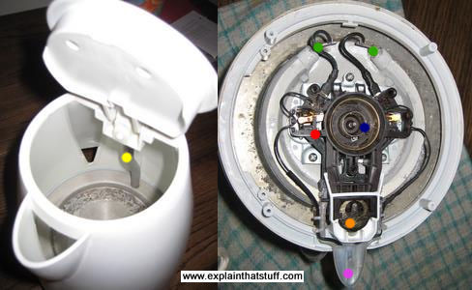
Interior design:

Slide 9
Features of electric kettle :
Electric kettles come with various features designed to enhance functionality, convenience, and safety.
Variable Temperature Control: Some electric kettles offer the ability to set and control the water temperature to suit different beverages. This feature allows you to select specific temperatures for brewing tea, coffee, or other hot beverages.
Rapid Boil: Electric kettles are designed to heat water rapidly, boiling it faster than traditional stovetop kettles. This feature saves time and energy.
Keep Warm Function: Certain electric kettles have a keep warm function that maintains the water at a desired temperature for a set period. It can be useful if you want to keep the water hot for multiple servings or if you need hot water readily available for a prolonged period.
Cordless Operation: Many electric kettles come with a detachable kettle from the power base, allowing for cordless operation. This feature makes it easy to pour the hot water without the restriction of a cord, providing convenience and flexibility.
Water Level Indicator: Electric kettles typically have a water level indicator, often marked with minimum and maximum water level indicators. This feature helps you accurately measure the amount of water you need and prevents overfilling or using too little water.
And many more.....

Slide 10

Thank you

